Slide 1
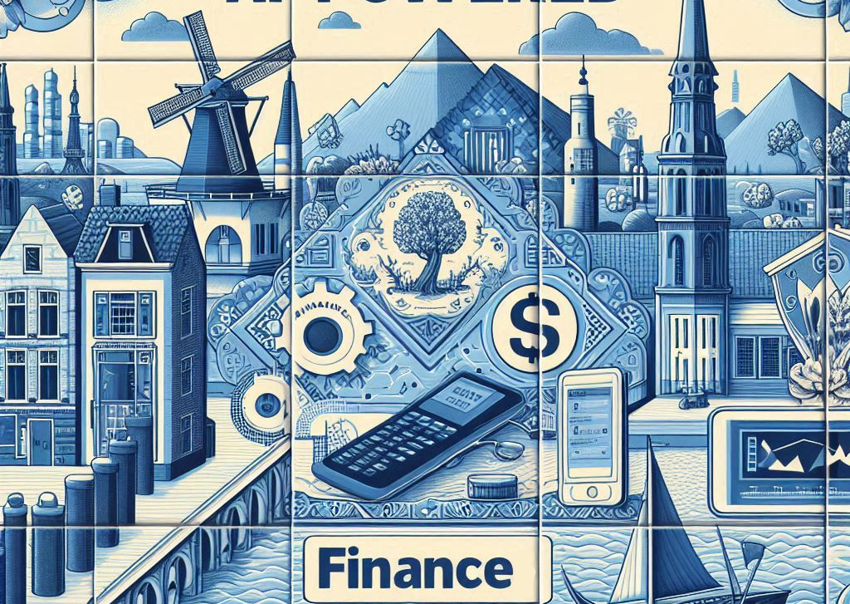
AI-Powered Finance
Paulo P
Notes:
Delft Blue Style

Slide 2
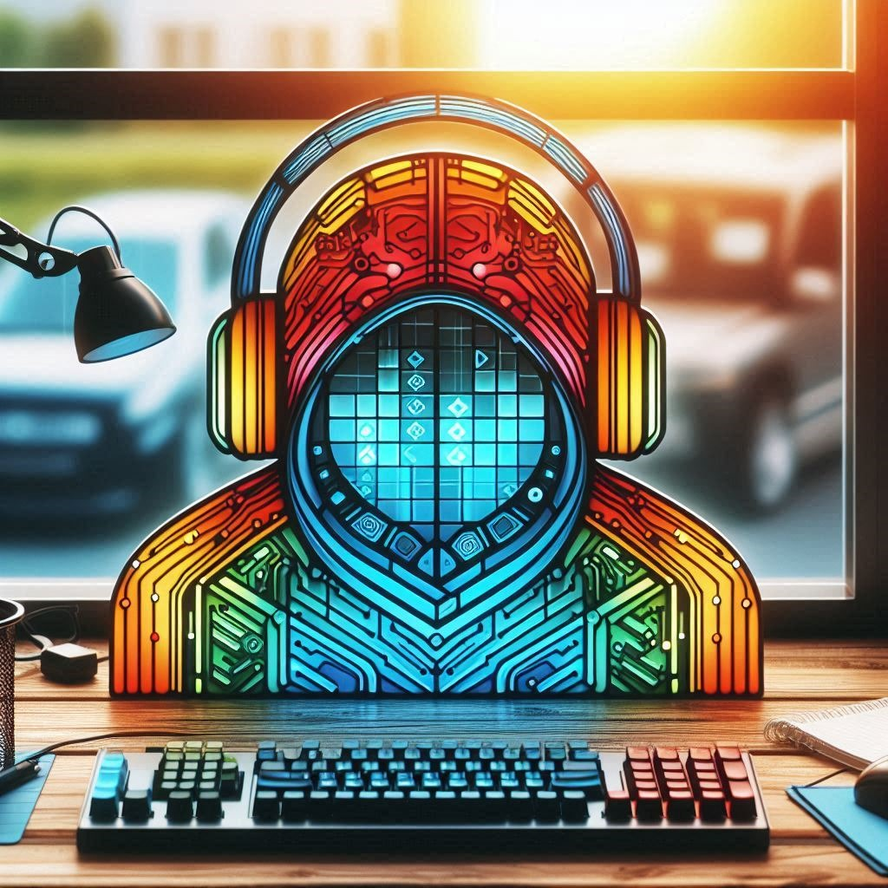
Future of AI
The Future of AI
Opportunities
Challenges
Impact on various field:
Physics
Medicine
Economics

Slide 3
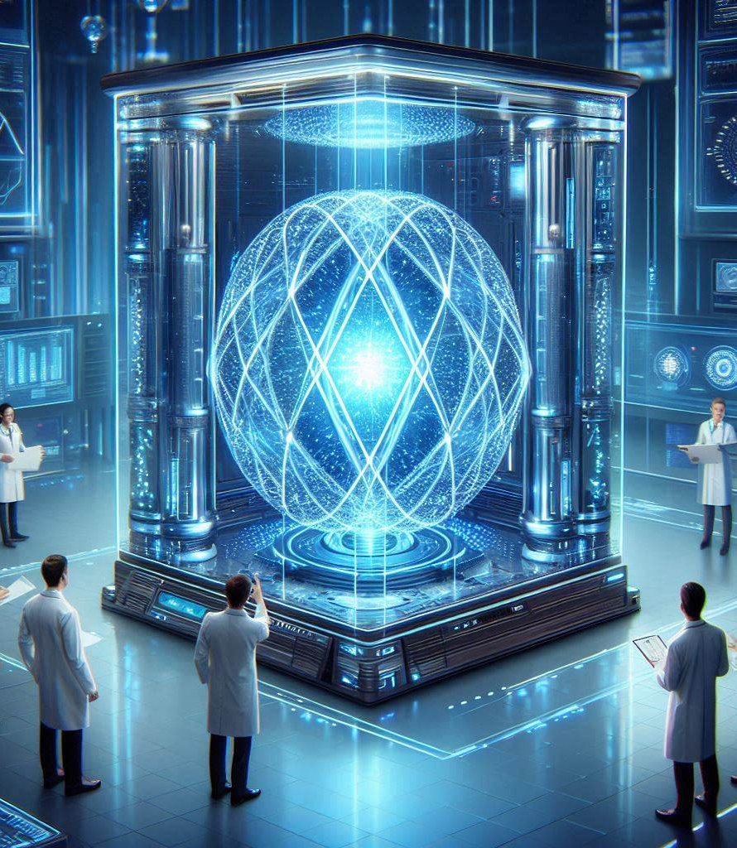
Accelerating Construction of Systems
The speed of construction of systems is accelerating, and AI will enable humans to build complex systems quickly.

Slide 4
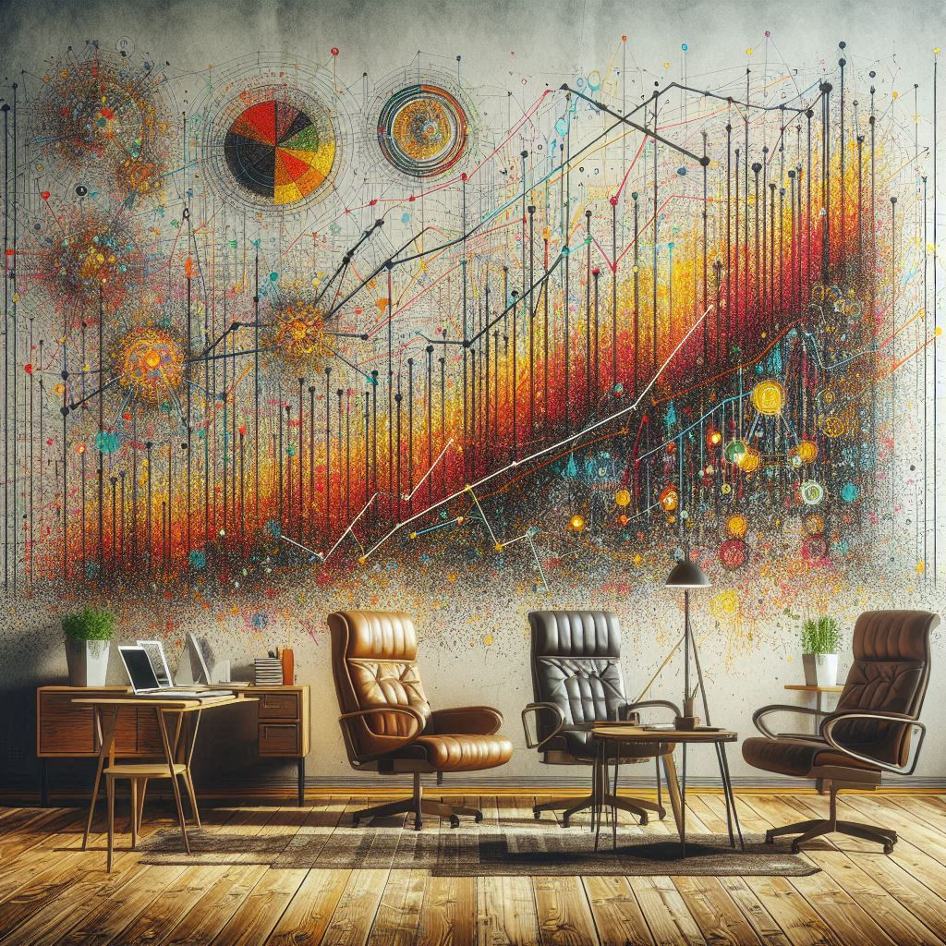
Increased Productivity
AI will increase productivity, potentially doubling it, and this could lead to significant economic growth and changes in the job market.
Notes:
Jackson Pollock style

Slide 5
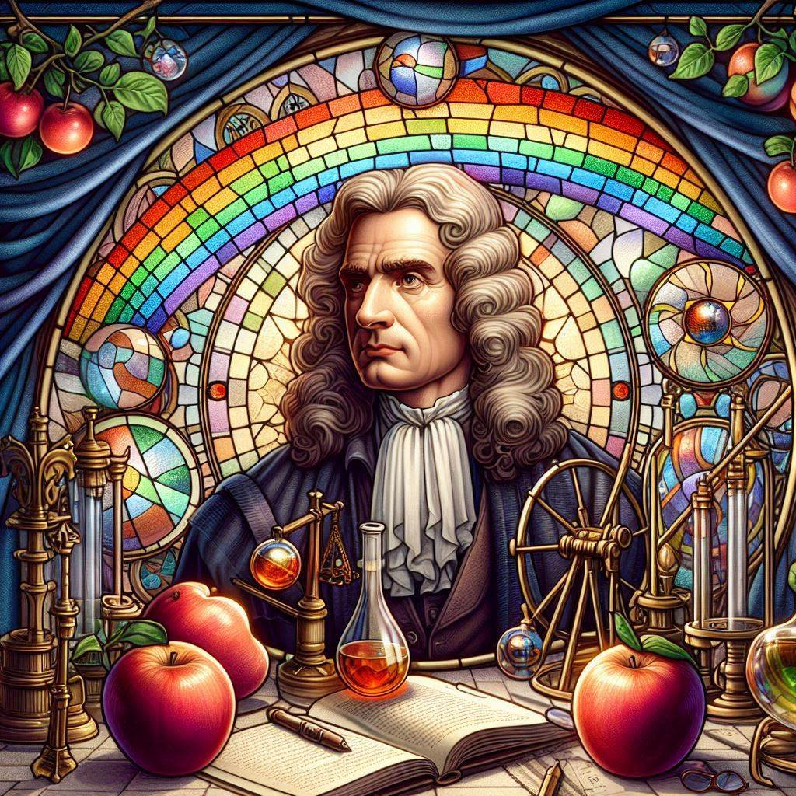
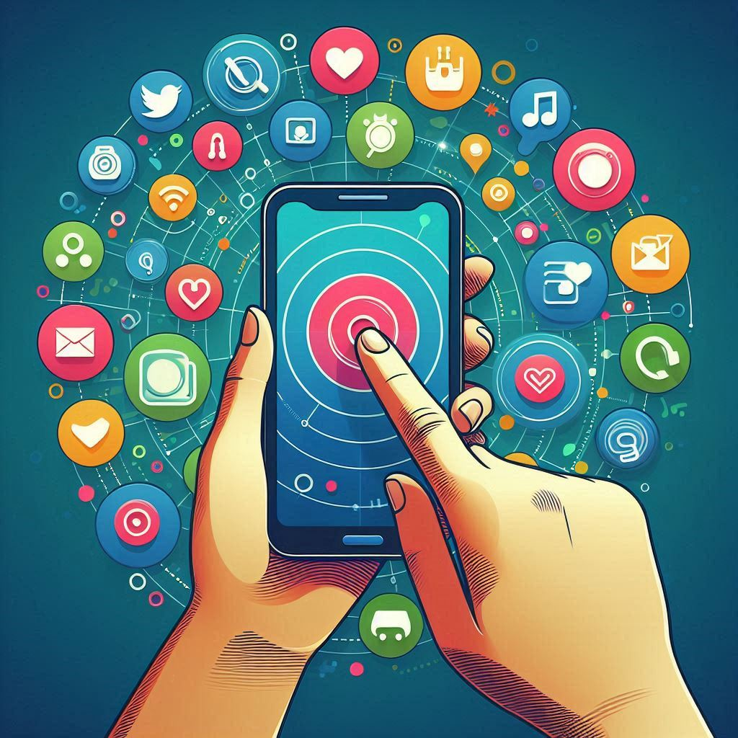
Polymaths
A polymath (Greek: πολυμαθής, romanized: polymathēs, lit. 'having learned much'; Latin: homo universalis, lit. 'universal human')[1] or polyhistor (Greek: πολυΐστωρ, romanized: poly'īstor, lit. 'well-learned')[2] is an individual whose knowledge spans many different subjects, known to draw on complex bodies of knowledge to solve specific problems.

Slide 6
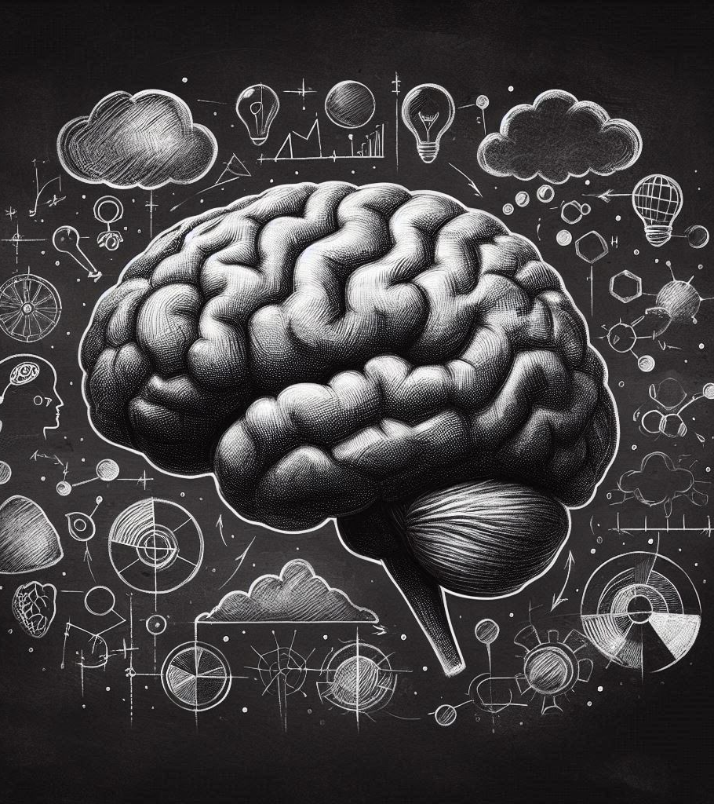
Challenges in Applying AI
There are still challenges in applying AI to fields like Physics, and AI is not yet capable of making creative leaps like Einstein's discovery of general relativity.

Slide 7
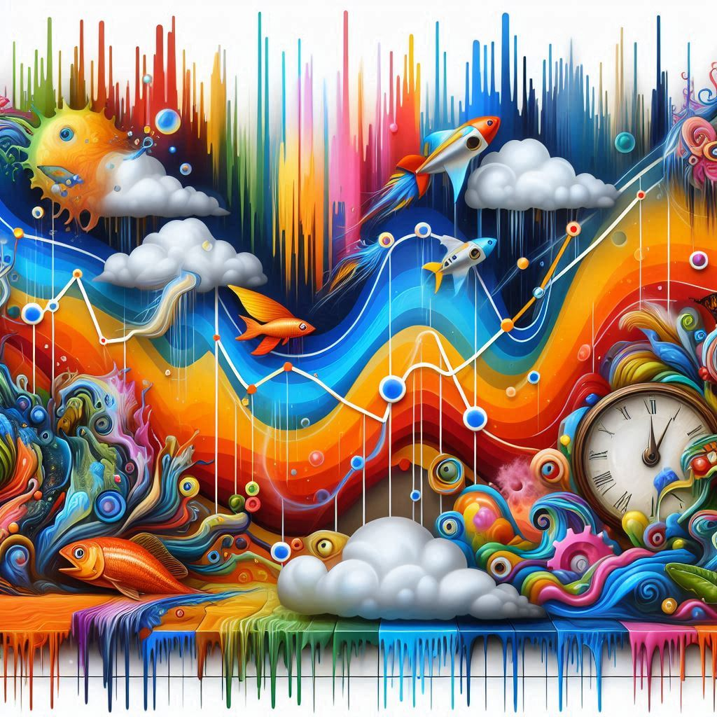
Benefits of AI
AI can be useful for solving complex problems that involve large amounts of data, and the benefits of AI are most pronounced when there is a large amount of data available.
Notes:
A graph showing the benefits of AI in the style of surrealism

Slide 8

Open-Source vs. Closed-Source AI Models
The debate around open-source vs. closed-source AI models, and the potential for copying adaptation open-source models.
Notes:
Draw me a picture of "A diagram of a lock and key" in the style of Morrocan cement tiles

Slide 9
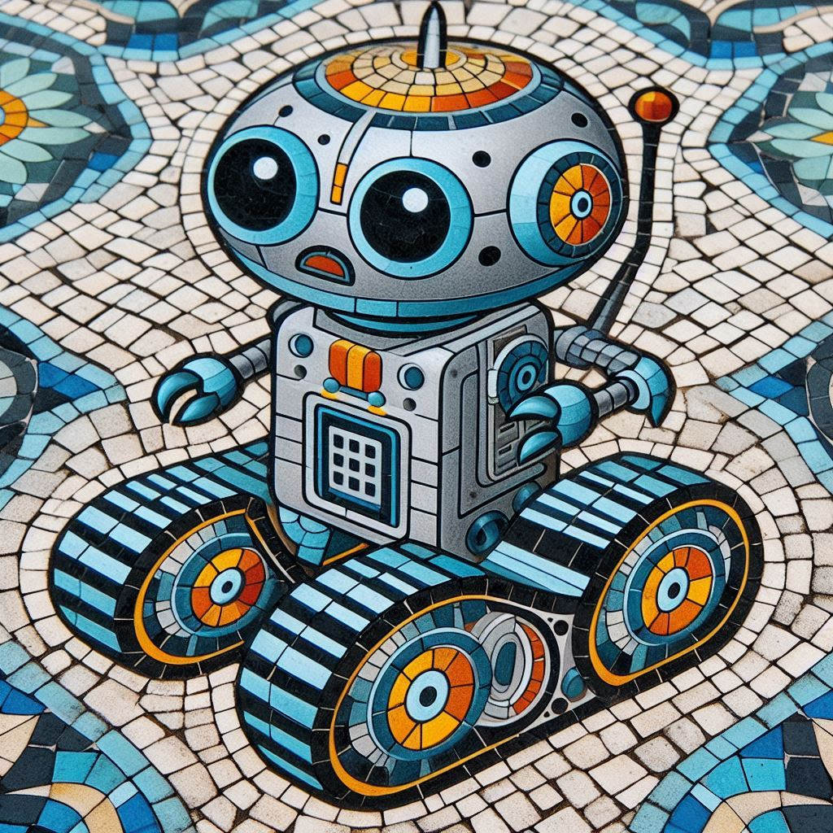
Development of Smaller AI Models
The development of smaller, more efficient AI models, such as the llama 2 model, which is 10 times smaller than the original model.

Slide 10
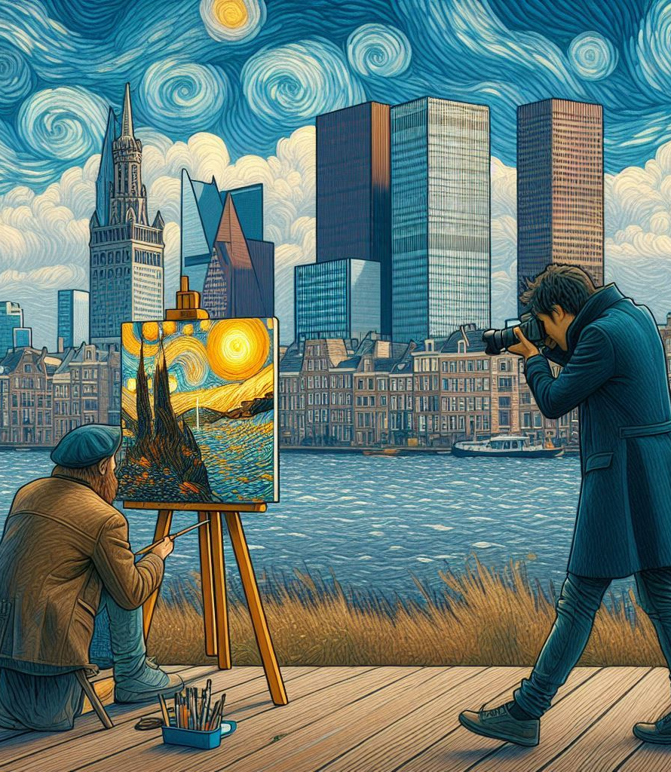
Potential for AI to Create New Forms of Content
The potential for AI to create new forms of content, such as synthetic videos and pictures, and the potential for AI to be used in marketing and advertising.
Notes:
Picture of an photograph taking a picture of a painter with Hague as skyline in style of Van Gogh

Slide 11

Potential for AI to Create New Forms of Misinformation
The potential for AI to create new forms of misinformation and disinformation, and the need for defenses against these types of attacks.
Notes:
Shield against misinformation Bahaus style

Slide 12
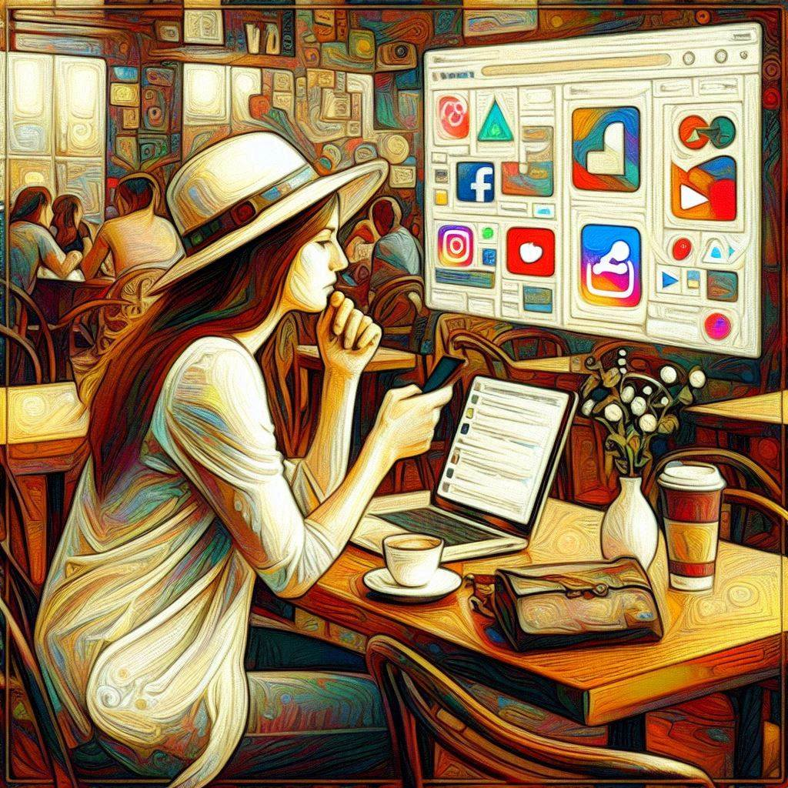
Potential for AI to Create New Forms of Social Media
The potential for AI to create new forms of social media, and the potential for AI to be used in social media platforms.
Notes:
Expressionism new ways of social media

Slide 13
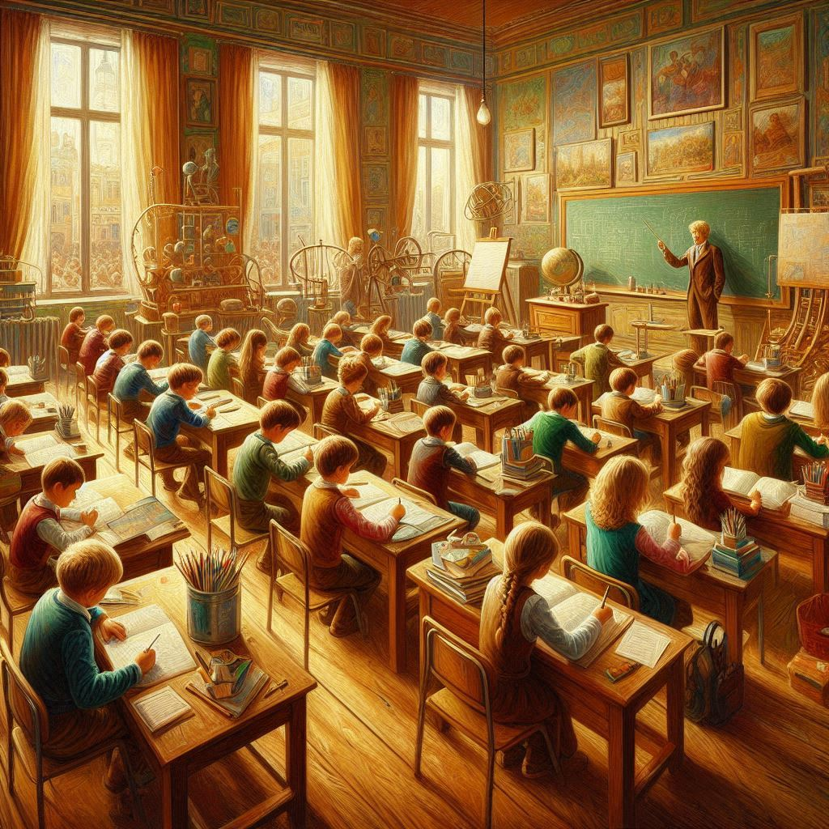

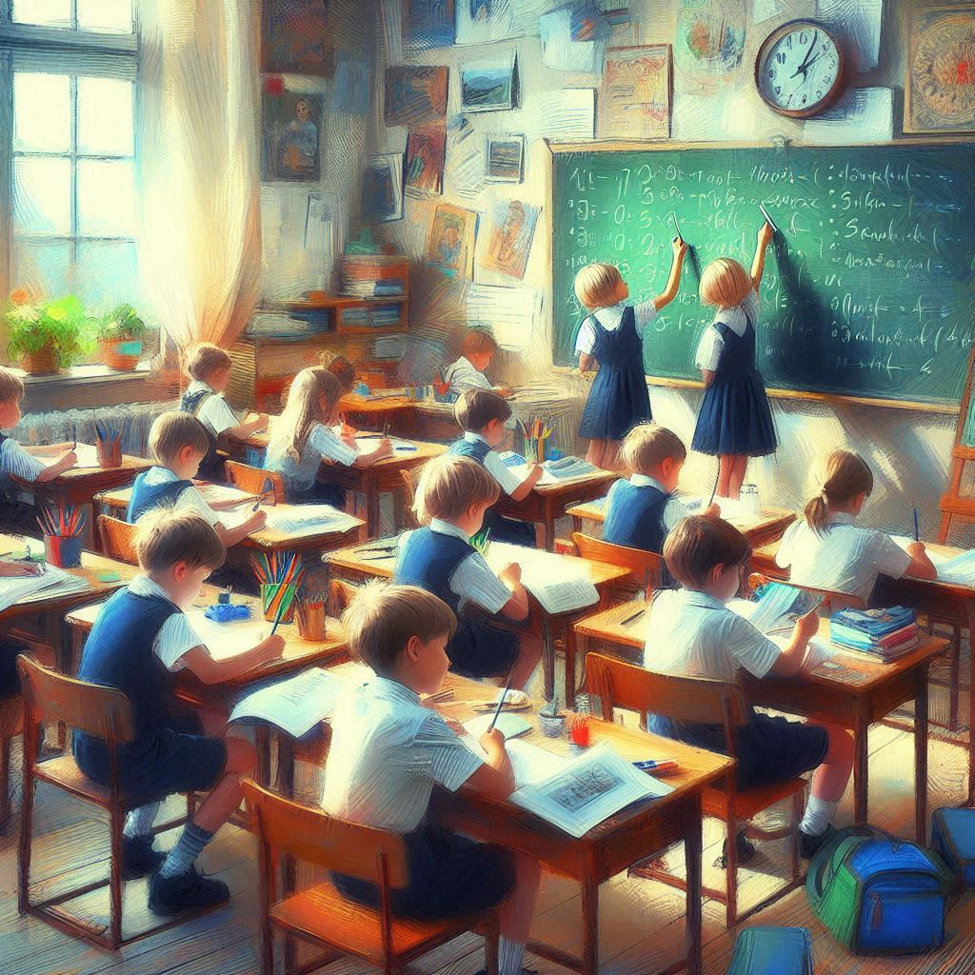
Potential for AI to Create New Forms of Education
The potential for AI to create new forms of education, such as an AI tutor that adapts to individuals' learning abilities and styles.
Notes:
Painterly style drawings of schooling children

Slide 14
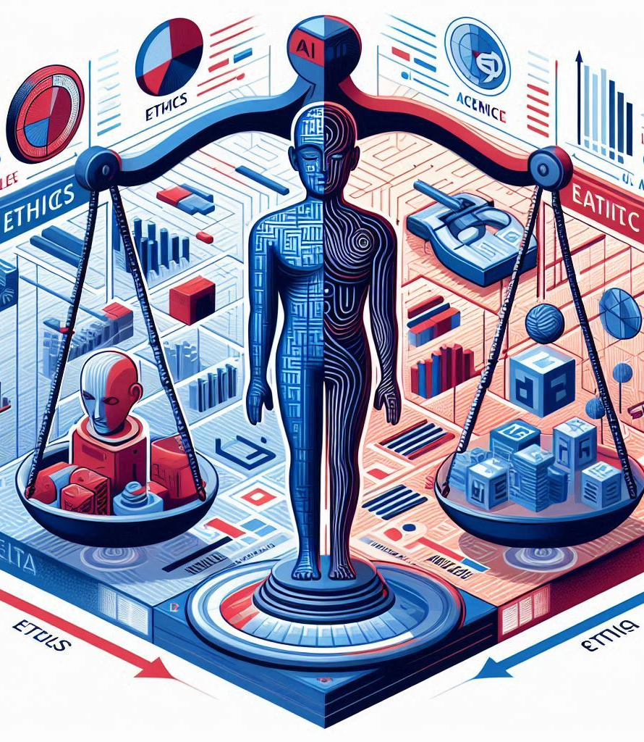
Discussion on AI and Ethics
The discussion on AI and ethics, including the potential for AI to create new forms of content and misinformation, and the need for defenses against these types of attacks.
Notes:
Cubism Ethics and AI

Slide 15
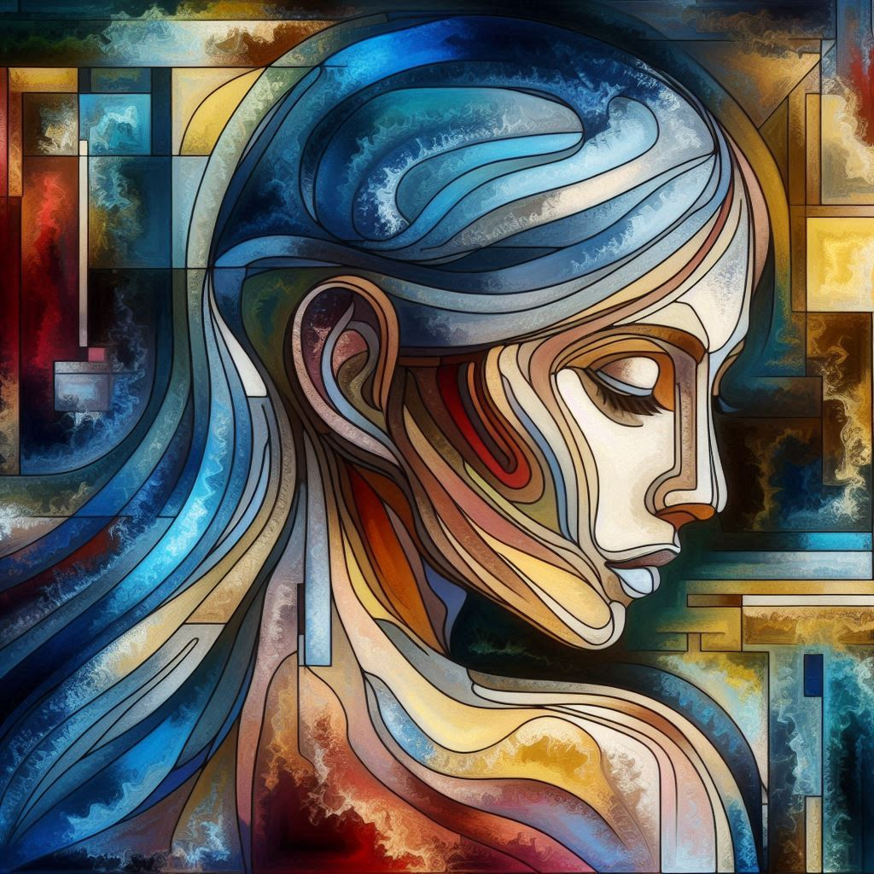
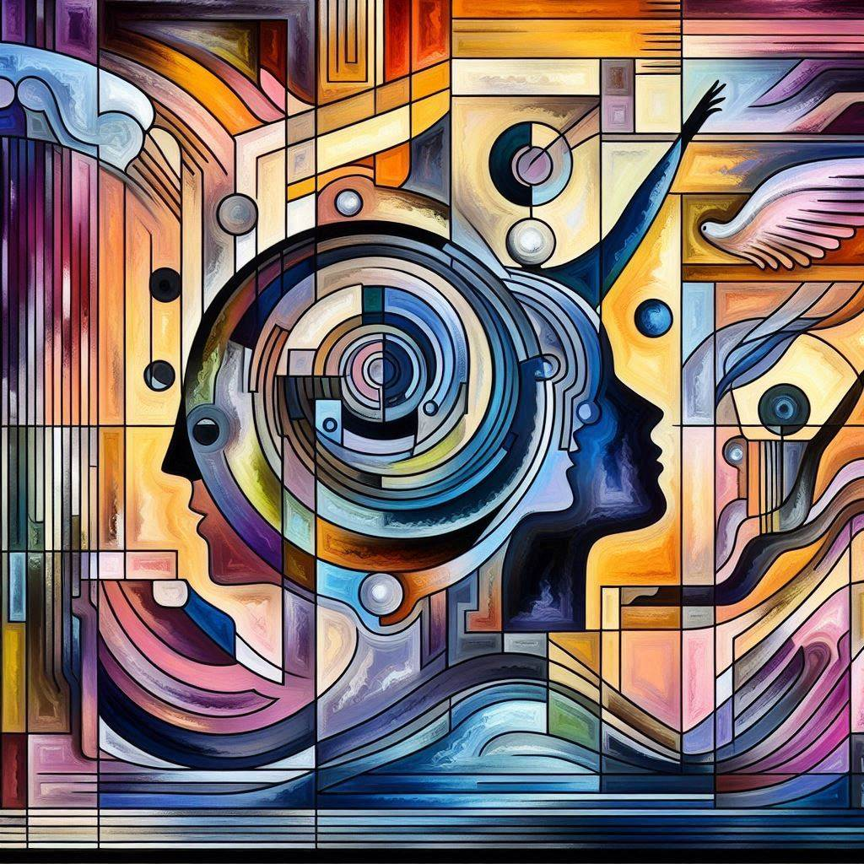
Conclusion
In conclusion, while there are valid concerns about the potential of AI systems: - Become too complex or opaque,
Ongoing research and development efforts aimed at making these systems:
Transparent
Interpretable
Aligned with human values
Are crucial steps towards harnessing their full potential responsibly.
Notes:
contain the ideas of concepts "Transparency, Interpretability, and Alignement with human values" in the style of Abstract Art

Slide 16

Demo
Showcase a Streamlit application
Integration with API
Customization
Notes:
Tainted Glass

Slide 17

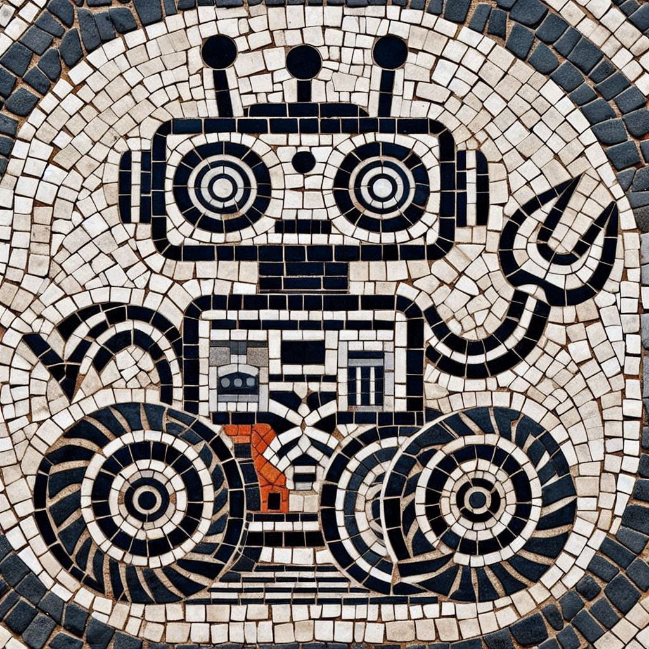
Questions
Questions
Linkedin
/in/ppaixao/
Github
https://github.com/paulospx
https://github.com/paulospx/ai-powered-finance
Thank you
Notes:
Cubism Ethics and AI

